Slide 1





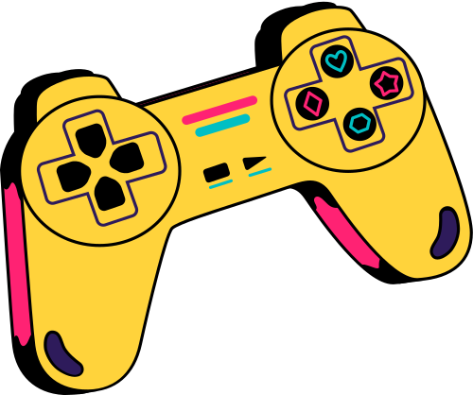
AI Agents for Strategic Board Games
START

Slide 2


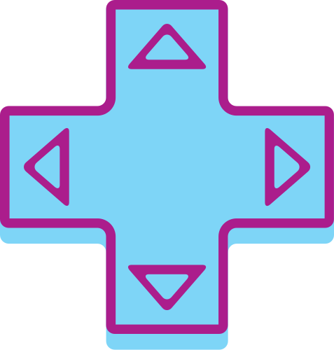
Introduction
Building multiple AI agents to play the same board game.
Selected game: Tic-Tac-Toe, a modified version 5*5.
Goal: Comparing different AI agents through tournaments.

Slide 3



problem statement
Games are classic AI benchmarks because they require
decision making, planning, and strategy.
This project compares three AI techniques:
• Rule-Based Reflex Agent
• Minimax Search Agent
• Learning Agent
The agents compete against each other to evaluate
performance, intelligence, and adaptability.

Slide 4
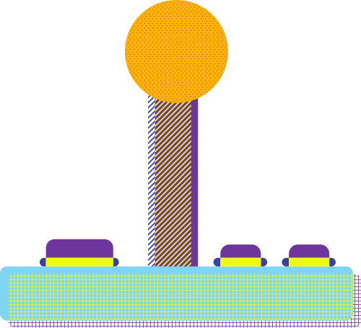


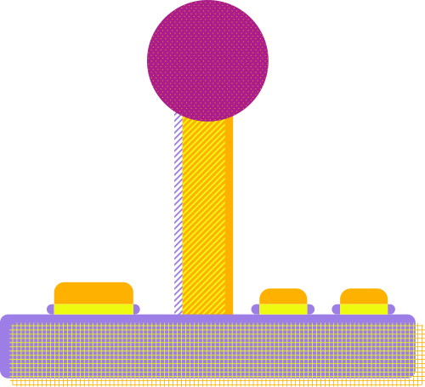
Implementation
How the game was implemented

Slide 5





Game engine
Rule-based agent
Minimax agent
Learning agent
Tournament

Slide 6
Game engine
Board Structure
5×5 Tic-Tac-Toe board
Two players: X and O
Empty cells represented by spaces
Legal Moves
A player can place a symbol in any empty cell
Turns alternate between players
State Representation
Each board configuration represents a game state
Stored as a 2D matrix
Terminal States
The game ends when:
A player gets 4 consecutive symbols
Horizontal
Vertical
Diagonal
OR the board becomes full (Draw)

Slide 7

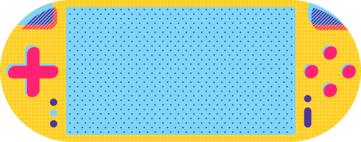
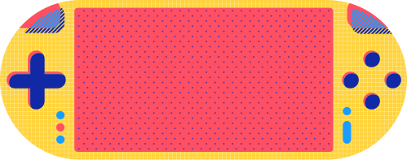
Rule-based agent
Description
The Rule-Based Agent is a simple reflex agent that makes decisions using predefined strategies instead of learning from experience.
Key Features
Fast decision making
No training required
Uses heuristic strategies
Easy to implement
Implemented Rules
Play a winning move if available
Block opponent winning moves
Create fork opportunities
Take the center position
Take corner positions
Choose a random valid move
Limitations
Cannot learn from previous games
Predictable behavior
Limited strategic depth

Slide 8
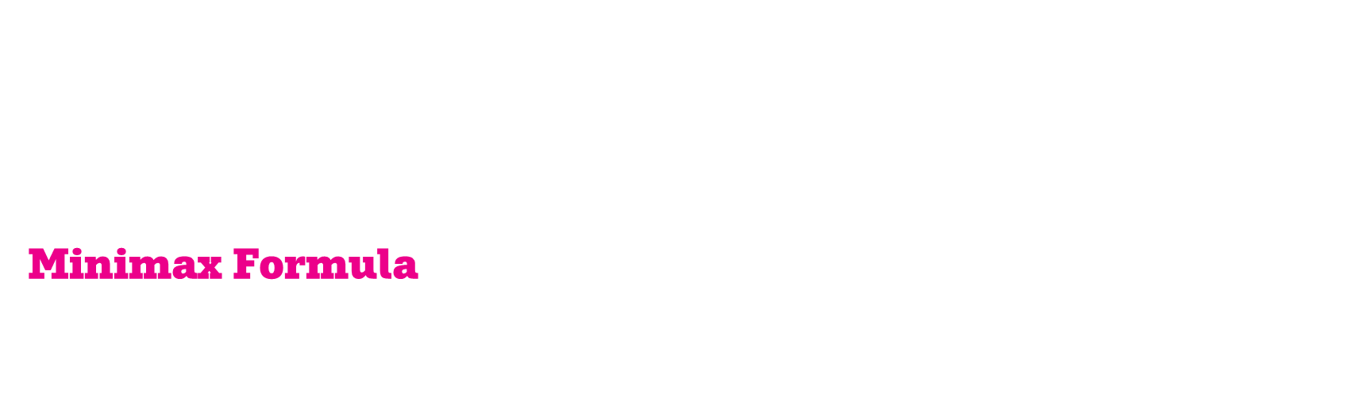
Minimax agent
Description
The Minimax Agent uses adversarial search to choose the optimal move by exploring future game states.
The algorithm assumes:
The AI player tries to maximize the score
The opponent tries to minimize the score
Alpha-Beta Pruning
The algorithm uses Alpha-Beta Pruning to reduce unnecessary searches.
Purpose
Speed up decision making Eliminate branches that cannot affect final result.
The agent simulates future moves and selects the best possible outcome.
Minimax Formula
$$f\left(x\right)=max⁡\left(min⁡\left(\text{future} \text{game} \text{states}\right)\right)$$

Slide 9
Learning agent
Description
The Learning Agent uses Q-Learning, a reinforcement learning technique, to learn optimal moves by playing many games against itself.
It improves over time by updating a Q-table based on rewards and penalties.
The mechanism
The agent learns:
Good moves = high reward Bad moves = low reward
It stores knowledge in a Q-table:
(State, Action) → Value (Q-value)
Advantages
Learns automatically (no manual rules)
Improves with experience
Adapts to opponent strategies
Limitations
Needs large training time
Requires many games to learn well
Memory intensive (Q-table grows large)

Slide 10

Tournament system
Purpose
The tournament system was designed to evaluate and compare the performance of different AI agents.
Agents play multiple matches against each other under the same conditions.
After all games:
Total wins
Draws
Win percentages
Final ELO ratings
are displayed and analyzed.

Slide 11


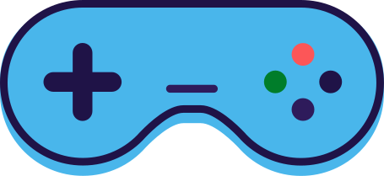
GUI

Slide 12
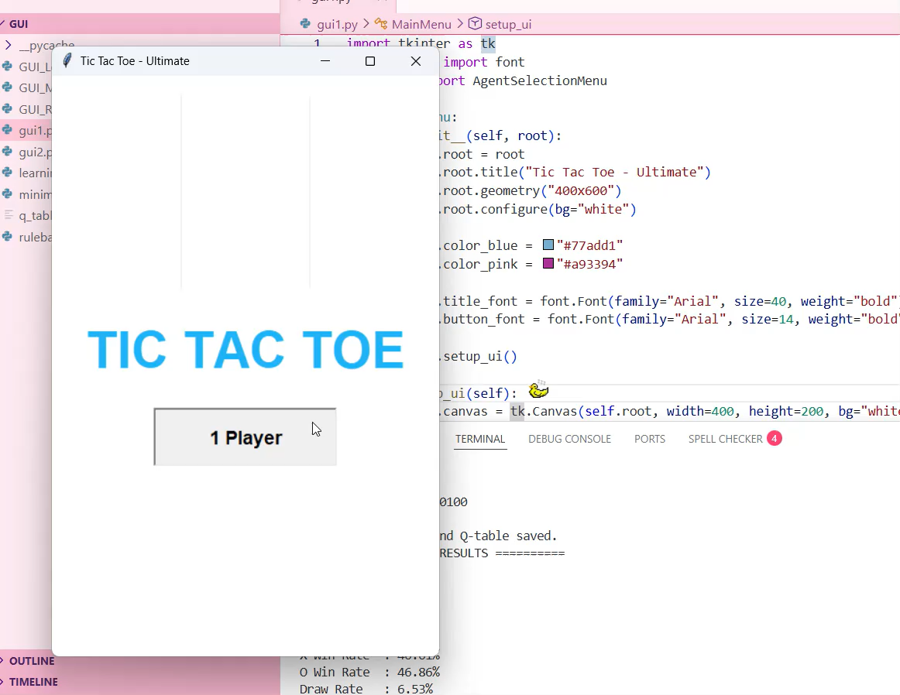

Slide 13
Results
The results indicate that the Minimax and Rule-Based agents perform at a relatively similar level in direct competition, while the Q-Learning agent shows weaker performance in its current training state. This suggests that the Q-Learning model may require additional training episodes or parameter tuning to achieve stronger generalization.

Slide 14
Conclusion
This project demonstrates how AI can evolve from simple rule-based systems to advanced learning-based decision making in game environments.
We successfully built a 5*5 board game environment with a complete AI system.
Three different AI approaches were implemented:
Rule-Based Agent (heuristic-based decisions)
Minimax Agent (optimal adversarial search)
Learning Agent (experience-based improvement)

Slide 15

Future improvements
Improve Q-Learning training performance
Implement Deep Q-Learning (DQN)
Enhance Minimax optimization techniques
Add more advanced heuristics and strategies
Improve GUI design and user experience
Add difficulty levels and agent selection
Support online multiplayer gameplay
Expand evaluation metrics and analytics

Slide 16

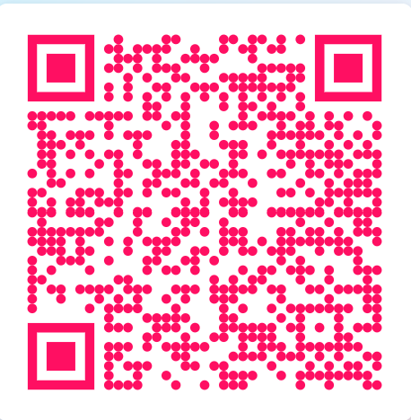
Scan and access all the files!

Slide 17
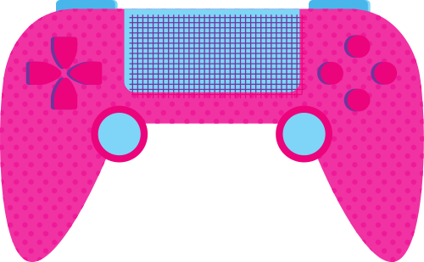
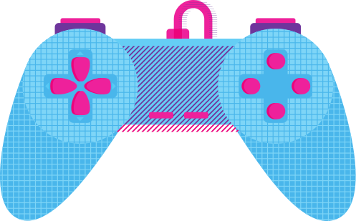
Our Team
nada mohamed ali 240481
Mariam mohammed sayed 240434
jana amr mohamed 240120
mariam yasser mohammed 240435
yehia farid yehia 240500
youssef walid hamdi 240523
youssef ismail ahmed 240508
youssef ayman abdelrehim 240510

